Slide 1
Battle of the Neighborhoods Coursera Capstone
By Michel D Antoine

Slide 2
Introduction
The battle of the neighborhoods will take place in Europe.
This work will analyze three different countries in Europe.
The countries I have chosen are France, Italy and Spain.
I also chose three regions within each of those countries for the battle to take place. In the country of France, Paris with its region Île-de-France, Rome, Italy and its region Lazio and Madrid, Spain.

Slide 3
The primary purpose of the battle is to showcase what each country has to offer to a foreigner or current citizen that wants to open up a business or move to a different part of the country.
These are all the capitals of their perspective countries and would give unique data on the surroundings of each peculiar country.
All are rich in history and offer unique forms of life styles.
Each capital has over 2 million people living within its area.

Slide 4
Background
France, Italy and Spain are famous tourist destinations in the world.
All three of these counties are multicultural European Union members known for their hospitality.
They are also known for being the financial districts within their areas.
All three members of the European Union speak different languages.
Restaurants play an important role when attracting tourist. Every city is unique in what it offers to a foreigner that comes there on a business trip or vacation.
All three of these countries are known for their food.

Slide 5
Potential Audience
What different types of clients or entrepreneurs are willing to invest in a business project overseas that would find this project interesting?
Business Entrepreneur after visiting country sees the potential of lucrative venture in opening a restaurant.
Tourist on vacation needing to know what restaurants and attractions are located in the area they are visiting.
Exchange Students who need to know what different types of places there are to eat while they are overseas studying.

Slide 6
Which towns are best suited for business or exchange students?
The towns or neighborhoods where the restaurants are set up determine how well a restaurant will do.
The more foot traffic the better chances are the restaurant will be successful.
It is vital that the area be well know throughout the world for its food.
This analysis is going to be based on which town or neighborhood is the best place to open up a restaurant.

Slide 7
Data Section

Slide 8
Data Sources
For this project I was unable to find the data in the csv format.
Some of the data was only in text format in large data files from certain web sites.
I imported all three of the countries files into different excel files but the data contained within them was not what I was looking for to complete this project.
Obtain the data from Wikipedia

Slide 9

Data Cleaning
Data cleaning is the process of preparing data for analysis.
removing or modifying data that is incorrect, incomplete, irrelevant, duplicated, or improperly formatted.
maximize a data set’s accuracy without necessarily deleting information.
fixing spelling and syntax errors, standardizing data sets
correcting mistakes such as empty fields, missing codes, and identifying duplicate data points.
create data sets that are standardized and uniform to allow business intelligence and data analytics tools to easily access and find the right data for each query.

Slide 10
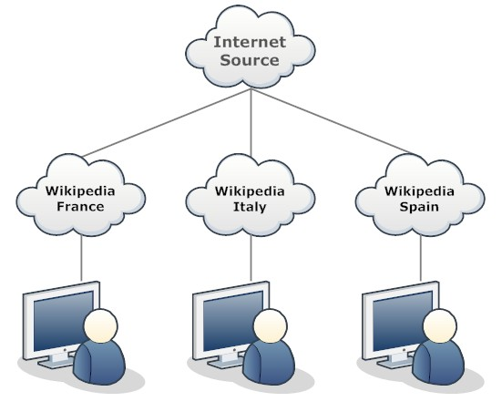
Source Wikipedia
containing specific search terms to gather the names of the towns / neighborhoods for France, Italy and Spain.
Additional data which was not in csv format was collected and combine with other excel files in csv format.
data was collected and imported into three separate Pandas dataframe
Some of the countries had the geo spatial coordinates information already within the csv files and others I had to acquire using Geolocation within Pandas.

Slide 11
Data Description
For this unique challenge I will be using the datasets I put together from Wikipedia
Foursquare API Data from the three different countries using their most popular cities and towns.
The Foursquare API contains information about the Snack Place, Winery, Hotel, Bakery, Restaurants, museums and many other types of place to visit or eat.
I selected a capital city with its neighboring towns of region. I selected one area within each country to analyze the neighborhood or region. The areas I chose are Île-de-France from France, Lazio, Italy and Madrid, Spain. Some of the visualizing of the towns / neighborhoods will come from Folium library. The Foursquare API will be use to explore data on the specific towns within each country. I will be using k-means clustering Algorithm from machine learning.

Slide 12
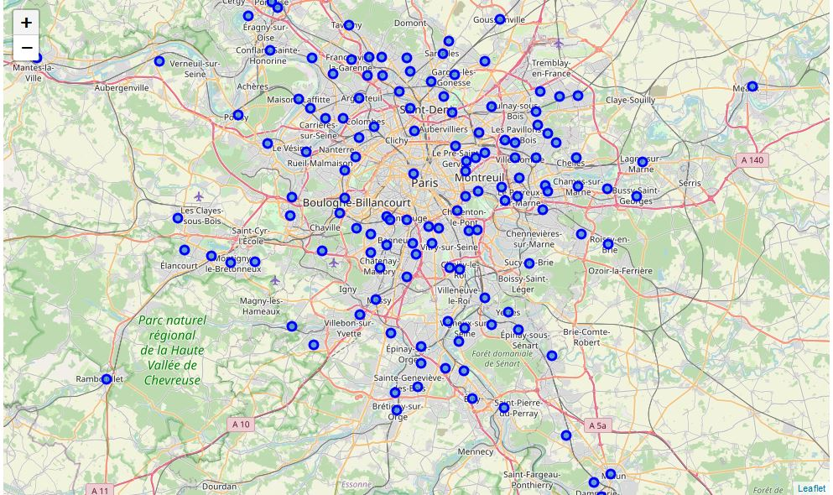
France Geolocation

Slide 13
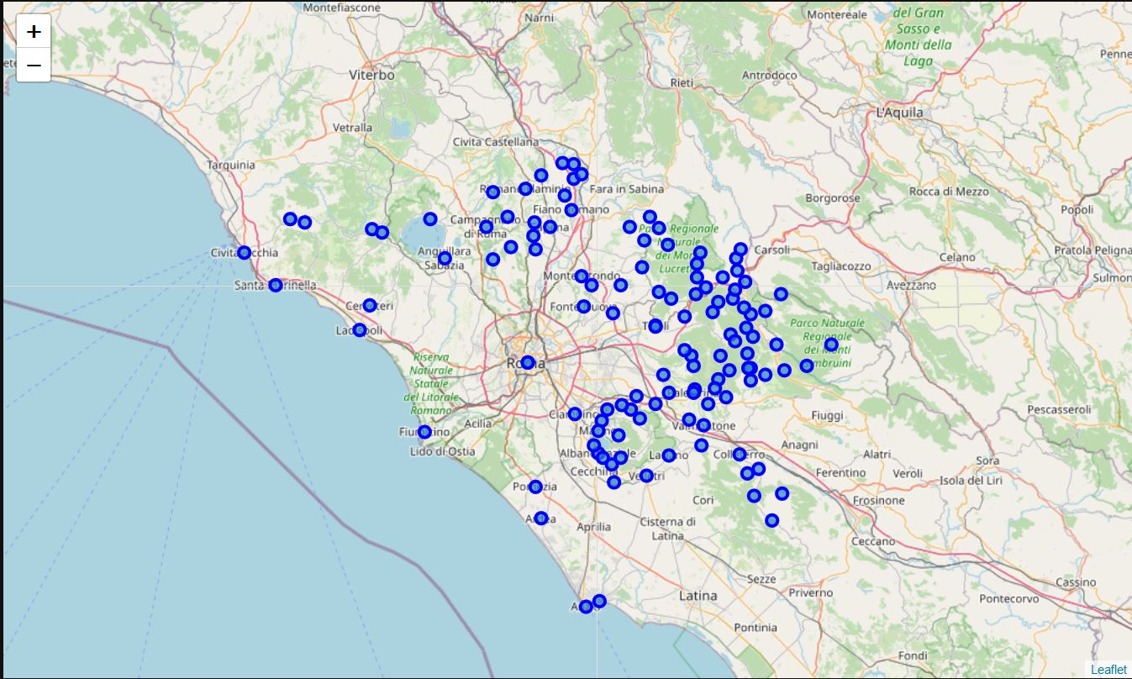
Italy Geolocation

Slide 14
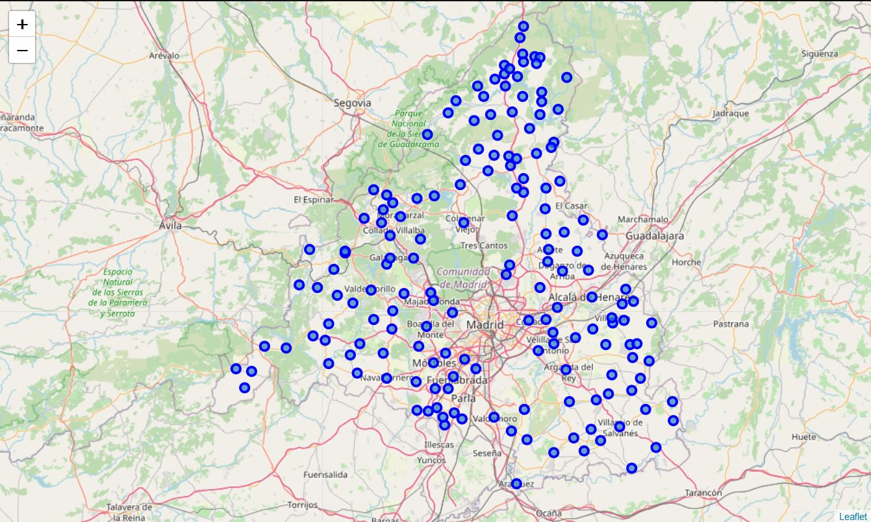
Spain Geolocation

Slide 15
Methodology Section
K-means clustering
unsupervised machine learning algorithm for partitioning a given data set into a set of k groups (i.e. k clusters)
where k represents the number of groups pre-specified by the analyst
classifies objects in multiple groups (i.e., clusters)
such that objects within the same cluster are as similar as possible
whereas objects from different clusters are as dissimilar as possible
each cluster is represented by its center (i.e, centroid) which corresponds to the mean of points assigned to the cluster.

Slide 16
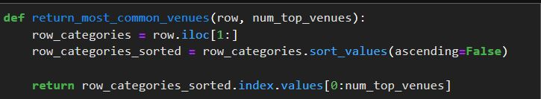
K-means Clustering
Before we get to the cluster we need to create a function to sort the venues from Foursquare API

Slide 17
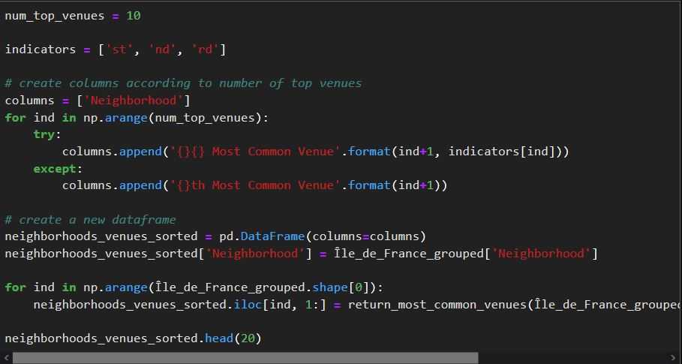
Code for 10 venues shown in descending order

Slide 18
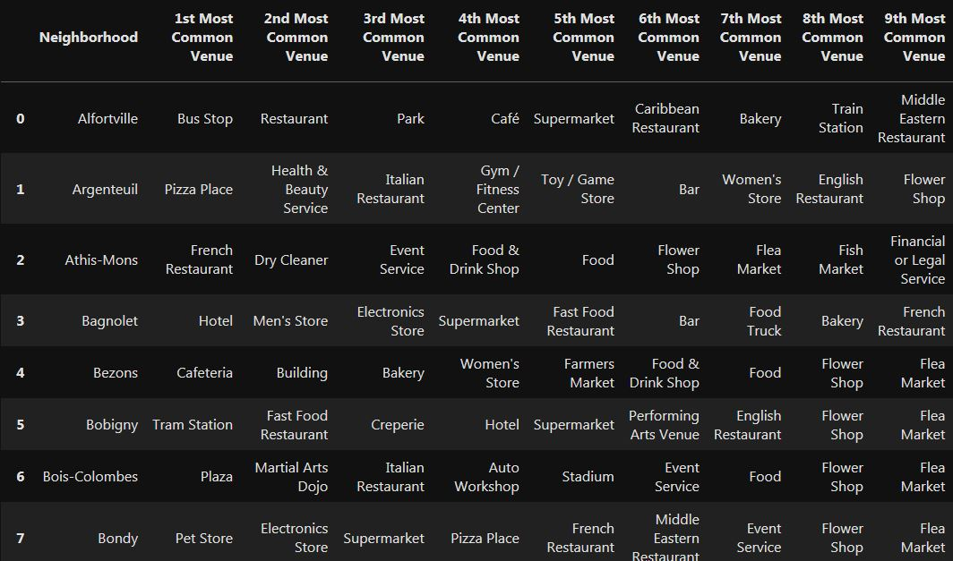
Results after running code for common top 10 venues

Slide 19
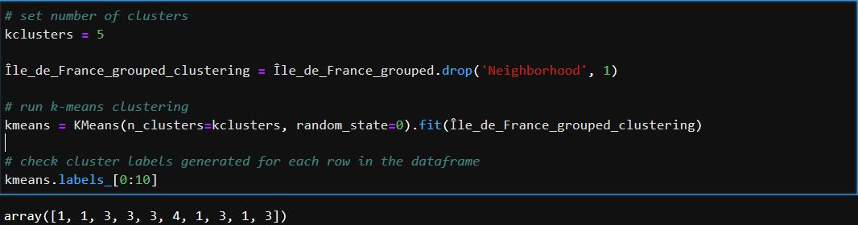
Clustering of Neighborhoods
k-means is set to a total of 5 clusters
The code is the same for the other countries

Slide 20
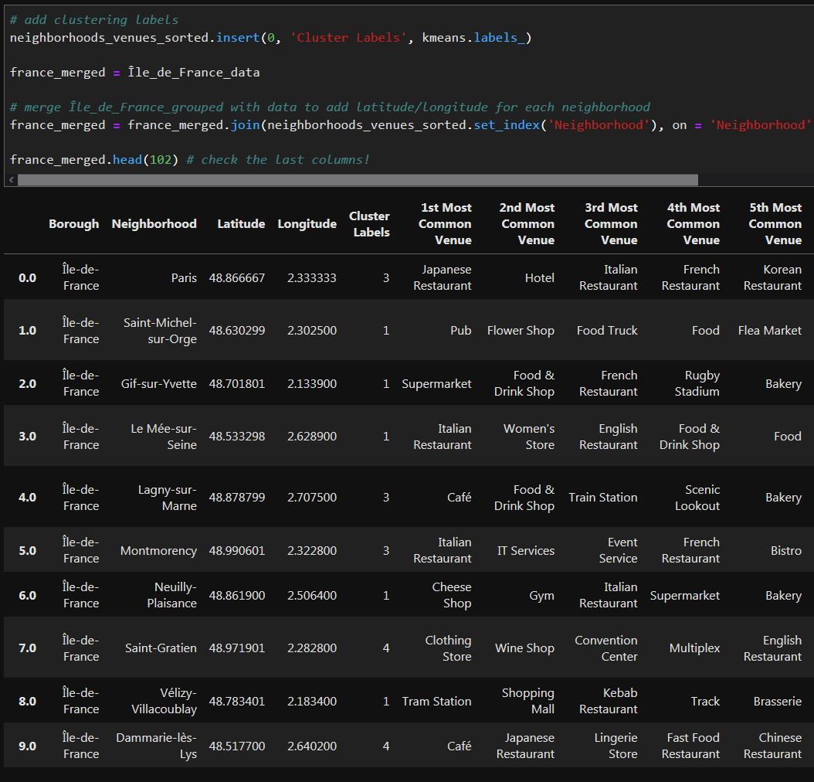
Cluster labels
During the process cluster labels are added

Slide 21
Results Section
We use folium map
Next we set the color scheme for the clusters
Also add markers to the map
Finally we then generate a map with the clusters
Each country has its own cluster map

Slide 22
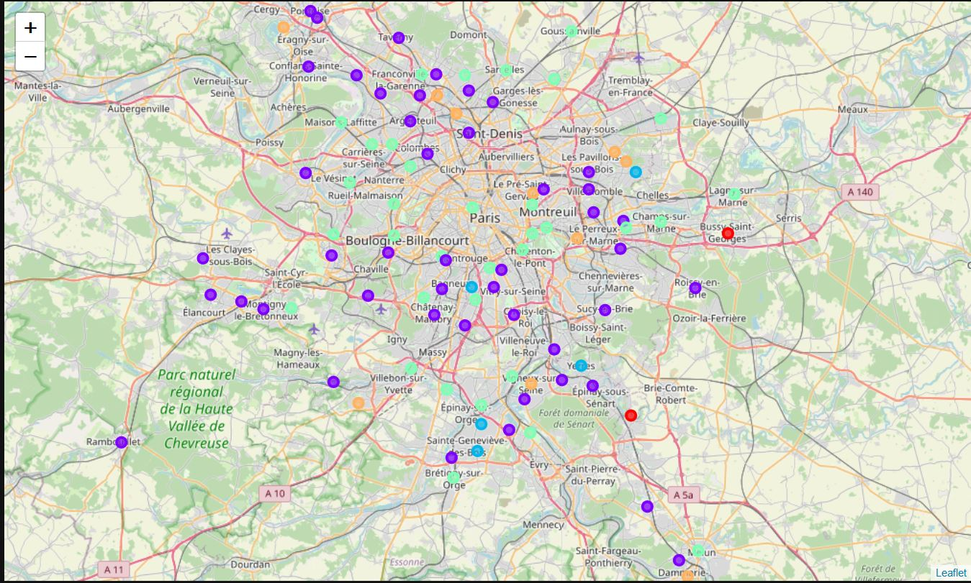
Map of France Clusters

Slide 23
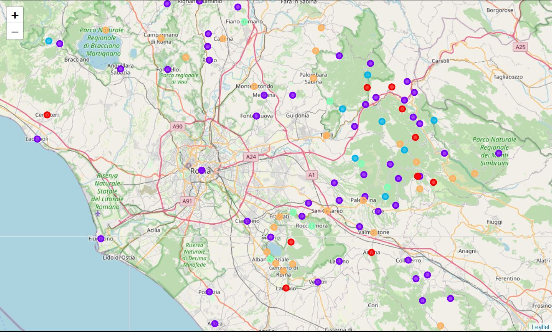
Map of Italy Clusters

Slide 24
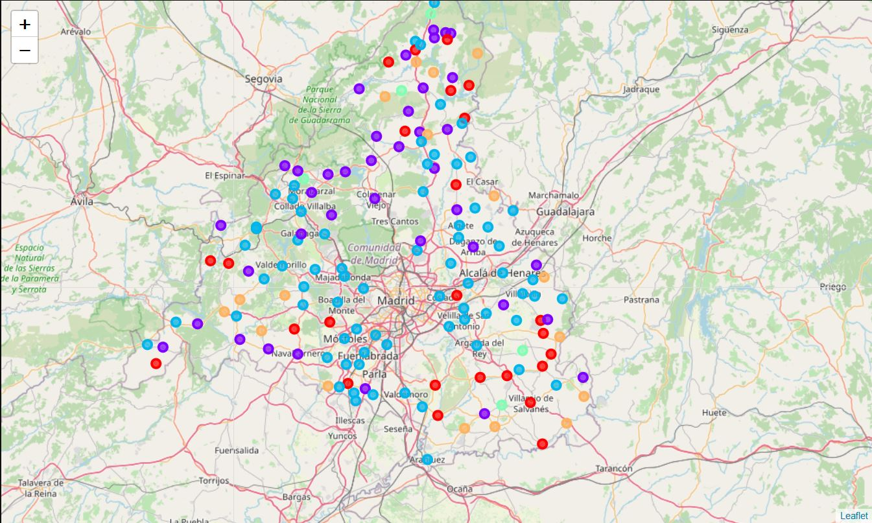
Map of Spain Clusters

Slide 25
Discussion Section
I set out to showcase the best value that each country had to offer
The resources within the specific areas
Each country’s unique value
Their rich culture, history, and tradition

Slide 26
Conclusion Section
The purpose of this capstone was to showcase the skills I gained from IBM Data Science course.
Within this process I was tasked with using the skills I learned from each module.
I gained the ability to use Pandas, Python, and K-means.
I used my data gathering skills to acquire the necessary data for the capstone project.
I used Pandas as the main source for cleaning the data.
I used Foursquare API for venue information within each country.

Slide 27
I created functions to sort venues.
I created new columns for top venues.
I set the number of k-means clusters to 5 and added labels.
I mapped the clusters using Folium and showcased the results for every one to make their own decisions.
One unique observation I found was that Spain’s K-means cluster looks like the head of a cow.

Slide 28
I took away from this course an understanding that data science is everywhere within the computer and business industry. This course was just a small stepping stone to other areas within the data science field.
Thanks to IBM and their data scientist for sharing their knowledge and experience with all of us who are interested in data science.

Slide 29
Sources information
https://simplemaps.com/
https://www.sisense.com/glossary/data-cleaning/
https://uc-r.github.io/kmeans_clustering
https://www.wikipedia.org/

Slide 30
Libraries use in this Capstone project
Pandas - data analysis and manipulation tool, built on top of the Python
Numpy - numerical computing with Python
JSON- Library for json files
Geopy.geocoders- location data
Matplotlib - library for making 2D plots of arrays in Python
Sklearn - machine learning library that supports supervised and unsupervised learning
Folium- is a visualization library for Python

